Slide 1
In the Interest of Safety
Operation Lifesaver Presents:

Slide 2
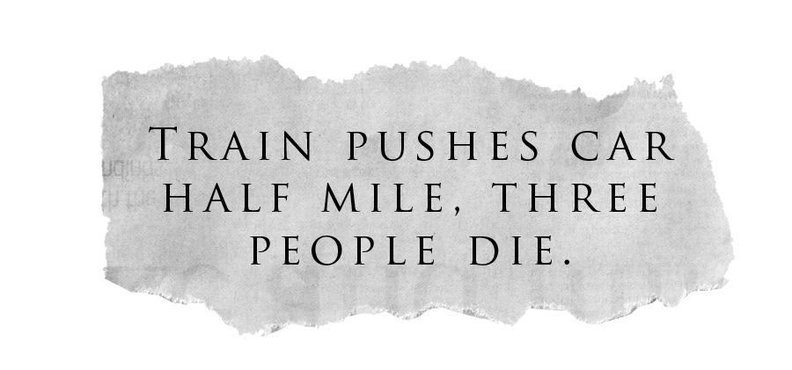

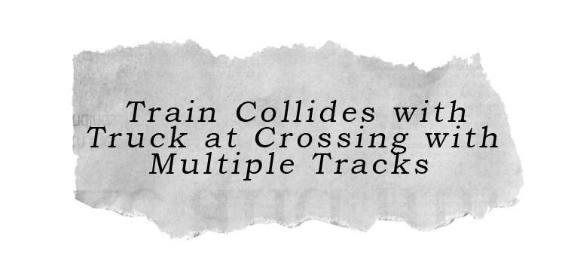
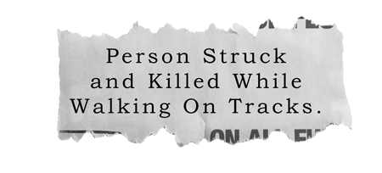
It Happens Every Day…
.
Copyright © 2014 by Operation Lifesaver, Inc. All rights reserved.

Slide 3
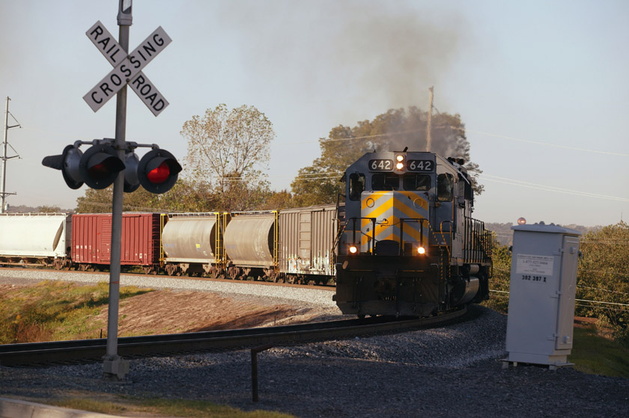
Any Time is Train Time
As you approach a railroad crossing, always expect a train.
Freight trains do not run on a schedule. Trains can run on any track, at any time,
from either direction.
Copyright © 2014 by Operation Lifesaver, Inc. All rights reserved.

Slide 4
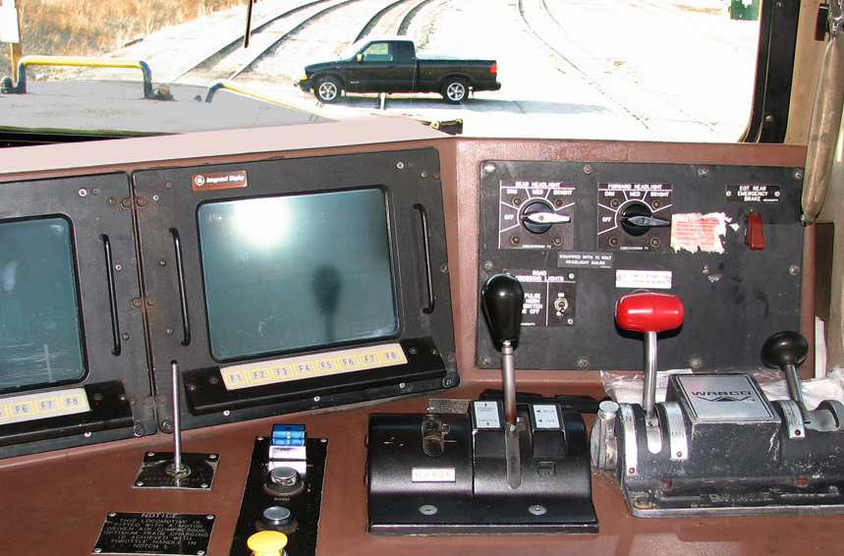
Trains Can’t Swerve
Trains don’t have a steering wheel, so they can’t go right or left.
Copyright © 2014 by Operation Lifesaver, Inc. All rights reserved.

Slide 5
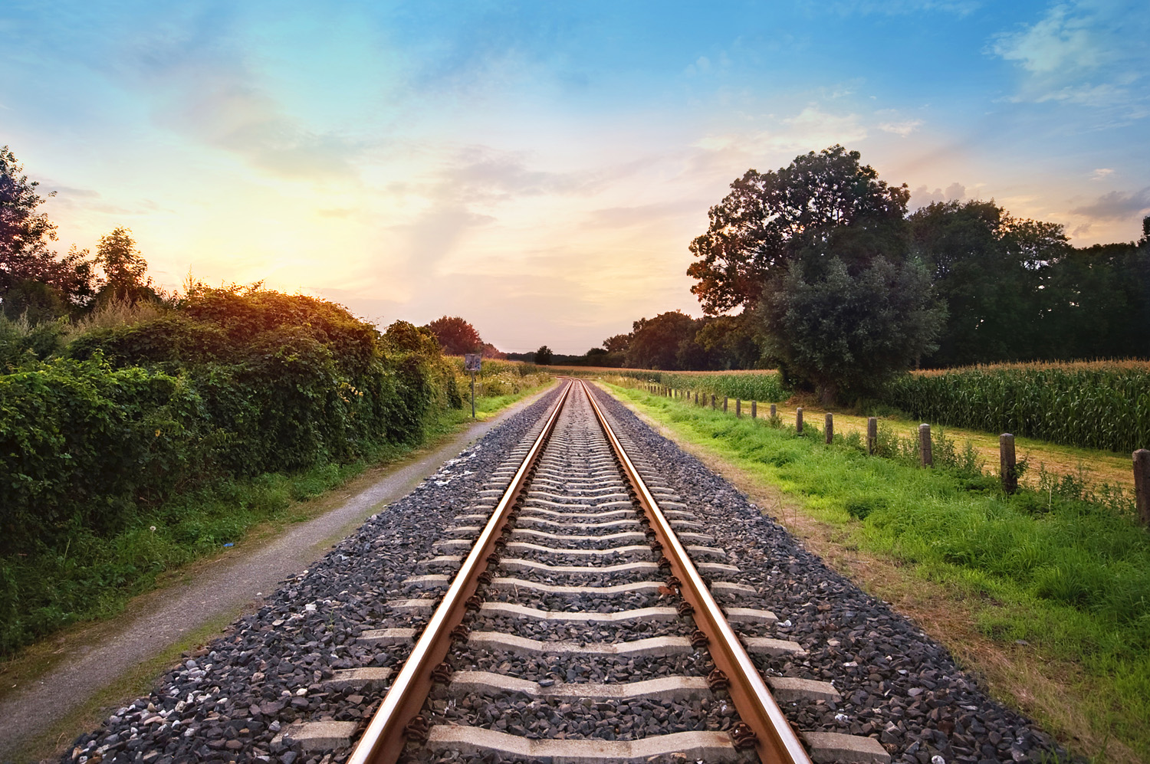
Approximate Stopping Distance
200 Ft.
Stopping distance of the average freight train is a mile or more. That’s 18 football fields.
Trains can stop, but they can’t stop quickly.
230 Ft.
When traveling at
55MPH
300 Ft.
600 Ft.
>5280 Ft.
Copyright © 2014 by Operation Lifesaver, Inc. All rights reserved.

Slide 6
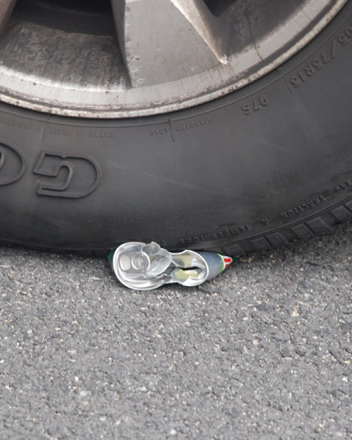
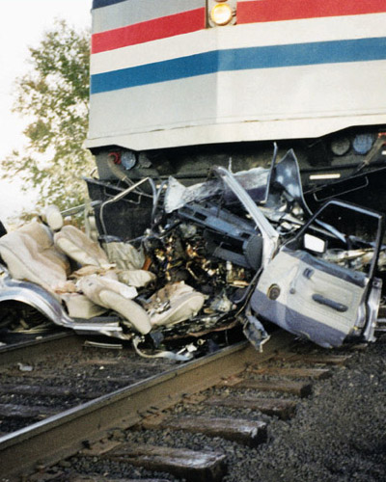
Weight Ratio
3,000 lbs.
12 Million lbs.
4,000 to 1 weight ratio
12 oz.
3,000 lbs.
A car crushing a can is the same as a train crushing a car.
Copyright © 2014 by Operation Lifesaver, Inc. All rights reserved.

Slide 7
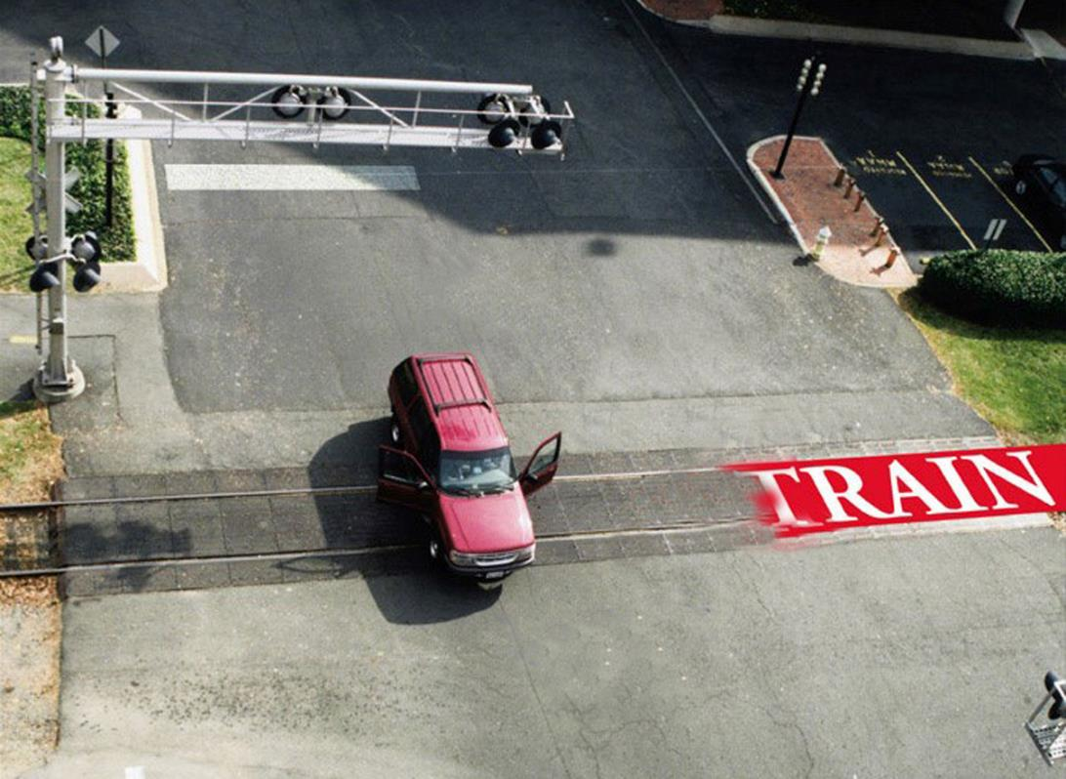
What Will You Do if
You Stall on the Tracks?
Get out!
Get away from the tracks, even if you do not see a train.
Locate the Emergency Notification System sign and call the number provided, telling them about the stalled vehicle.
45°
4. If a train is approaching, run toward the train but away from the tracks at a 45 degree angle. If you run in the same direction a train is traveling, you could be injured by
flying debris.
TRAIN
Copyright © 2014 by Operation Lifesaver, Inc. All rights reserved.

Slide 8
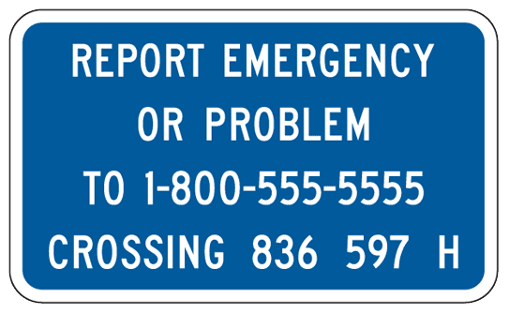
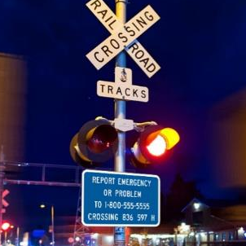

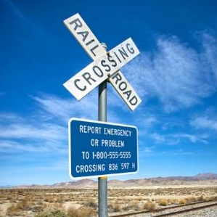
Emergency Notification System (ENS)
In case of emergency, look for this blue sign that shows an emergency phone number.
Call the number and give the Department of Transportation (DOT) crossing number found on the sign to identify your location.
This sign may be located on the crossbuck post or signal post.
If you cannot locate the ENS sign, call 911 or the local police.
Copyright © 2014 by Operation Lifesaver, Inc. All rights reserved.

Slide 9
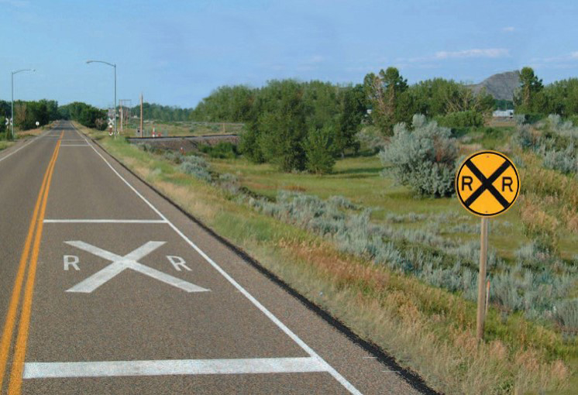
Approaching a Passive Crossing
You may see a round yellow Advance Warning sign that warns drivers that railroad tracks are ahead.
Pavement markings R X R, may be near the Advance Warning sign.
There is a no passing zone within 100 feet of the approach to a railroad crossing.
Copyright © 2014 by Operation Lifesaver, Inc. All rights reserved.

Slide 10
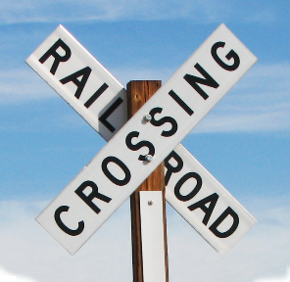
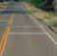
Passive Crossing
A passive crossing does not have flashing lights or automatic gates.
The crossbuck sign, required at all public railroad crossings, means to yield the right of way to the train.
A painted line identifies the safe place to stop when a train is approaching. If there isn't a line, stop no closer than 15 feet and no farther than 50 feet from the closest rail.
Copyright © 2014 by Operation Lifesaver, Inc. All rights reserved.

Slide 11
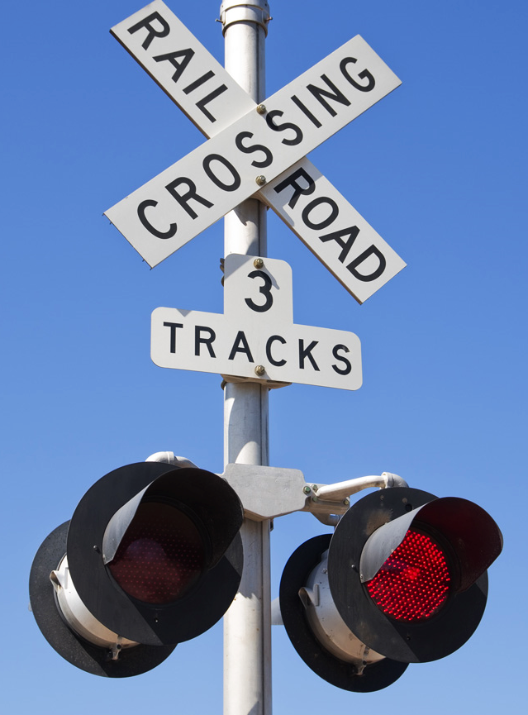
Active Crossing – Warning Devices
Flashing red lights warn of an approaching train and must be treated like a stop sign.
At crossings with flashing lights and no gates, you must stop. Proceed only when it is safe to do so.
Trains always have the right-of-way.
Copyright © 2014 by Operation Lifesaver, Inc. All rights reserved.

Slide 12
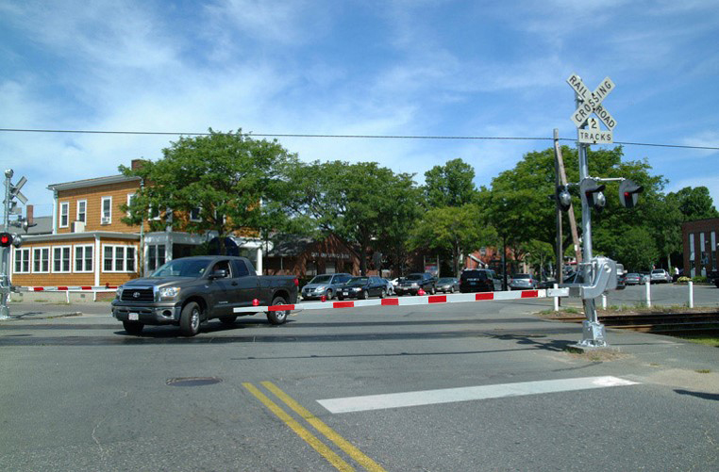
Driving Around the Gate
Flashing lights with gates close the road temporarily when a train is approaching.
Cross only when the gates are up completely and the lights have stopped flashing.
Driving around lowered gates is dangerous and illegal.
Copyright © 2014 by Operation Lifesaver, Inc. All rights reserved.

Slide 13
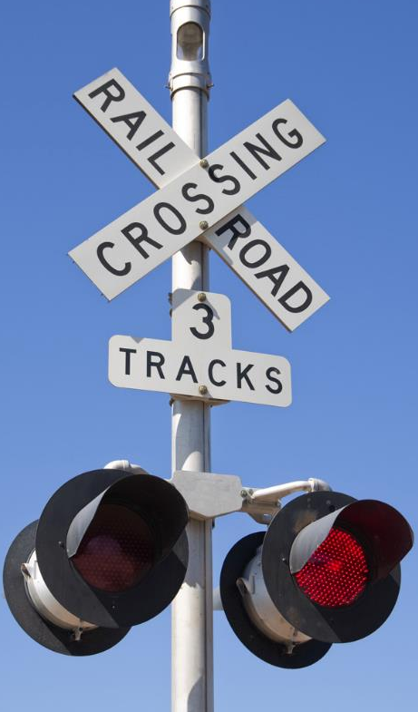
Multiple Tracks
Multiple Tracks Mean Multiple Trains
Check for a multiple track sign, which informs the driver how many sets of tracks are at that crossing.
Always make sure all tracks are clear before crossing any track. If there is a train in the crossing, after that train clears, make sure another train is not approaching on any other track from either direction.
Copyright © 2014 by Operation Lifesaver, Inc. All rights reserved.

Slide 14
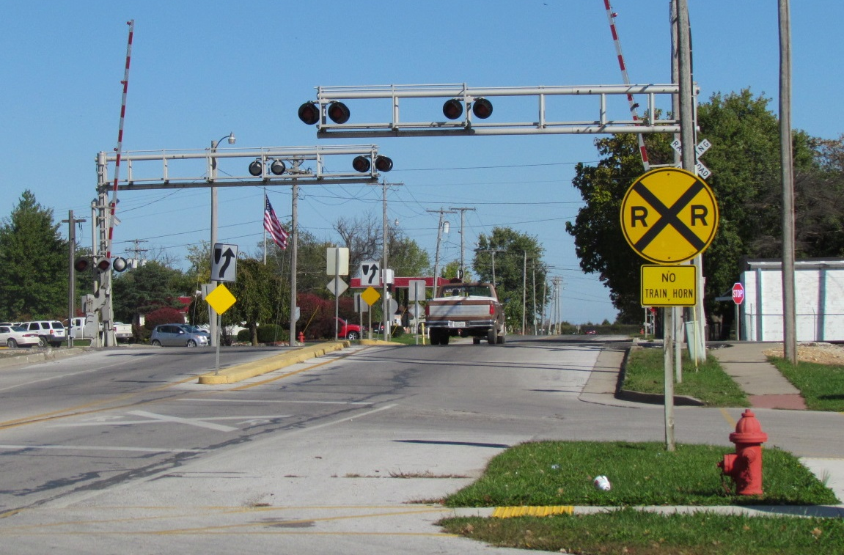
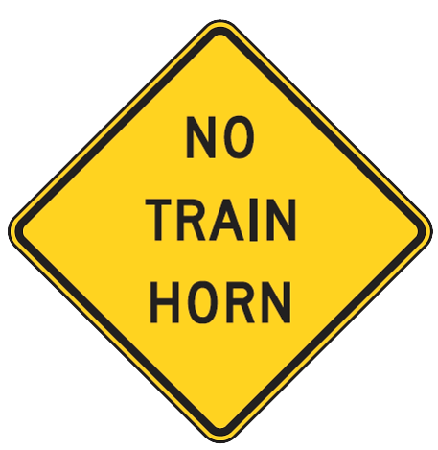
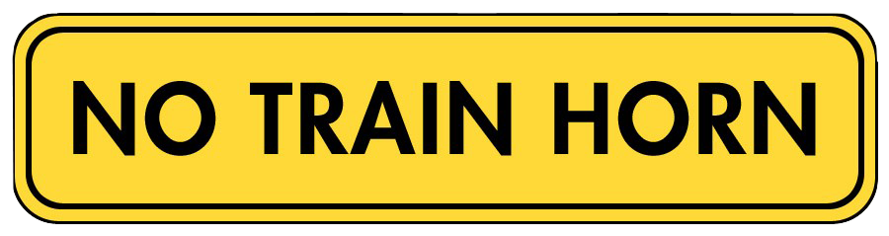
There May Not Always Be a Train Horn
Some communities have established Quiet Zones where train horns will not routinely sound.
Look for “No Train Horn”
signs that should be attached to the Advance Warning Sign.
For more information on the Federal Train Horn Rule and Quiet Zones, visit www.fra.dot.gov.
Copyright © 2014 by Operation Lifesaver, Inc. All rights reserved.

Slide 15

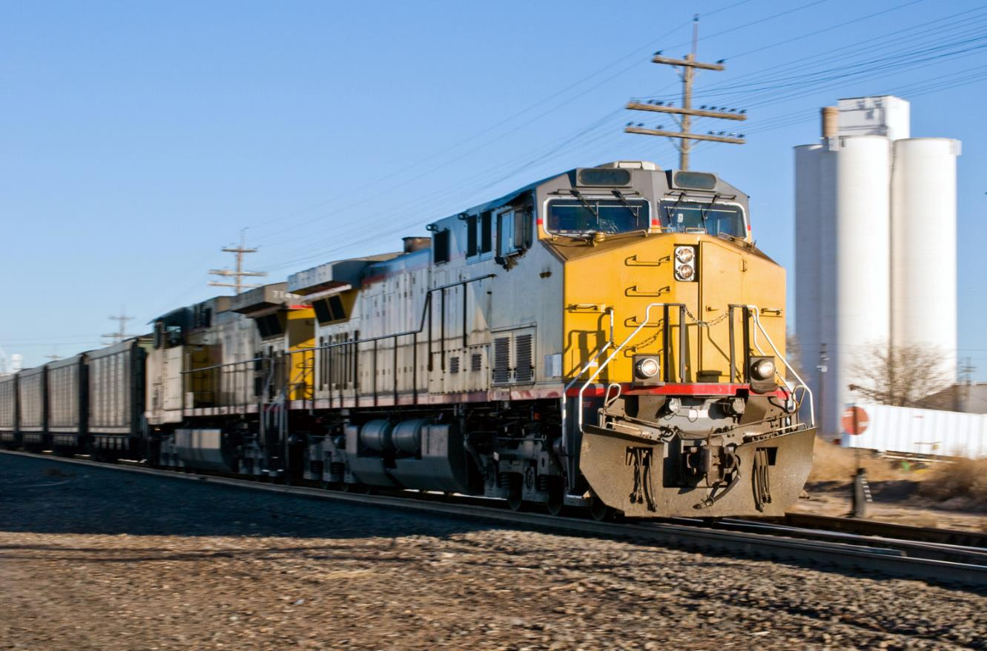
Speed Misperception
Airplanes look like they are almost hanging in mid-air but their landing speed is over 150 mph. The effects of the optical illusion are the
same with trains.
Because of their size, trains appear to be much further away and traveling much slower than their actual speed.
Copyright © 2014 by Operation Lifesaver, Inc. All rights reserved.

Slide 16

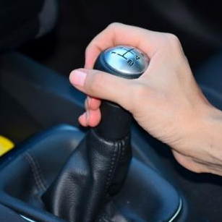
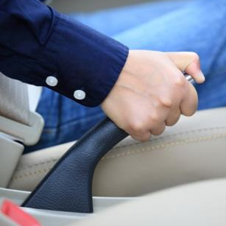
Three Don’ts
Don’t pass
on the tracks
Don’t shift gears
while crossing the tracks
Don’t stop
on the tracks
(it’s illegal)
When you stop, make sure the front and the back of your vehicle are 15 feet from the nearest rail.
15 ft.
15 ft.
Copyright © 2014 by Operation Lifesaver, Inc. All rights reserved.

Slide 17
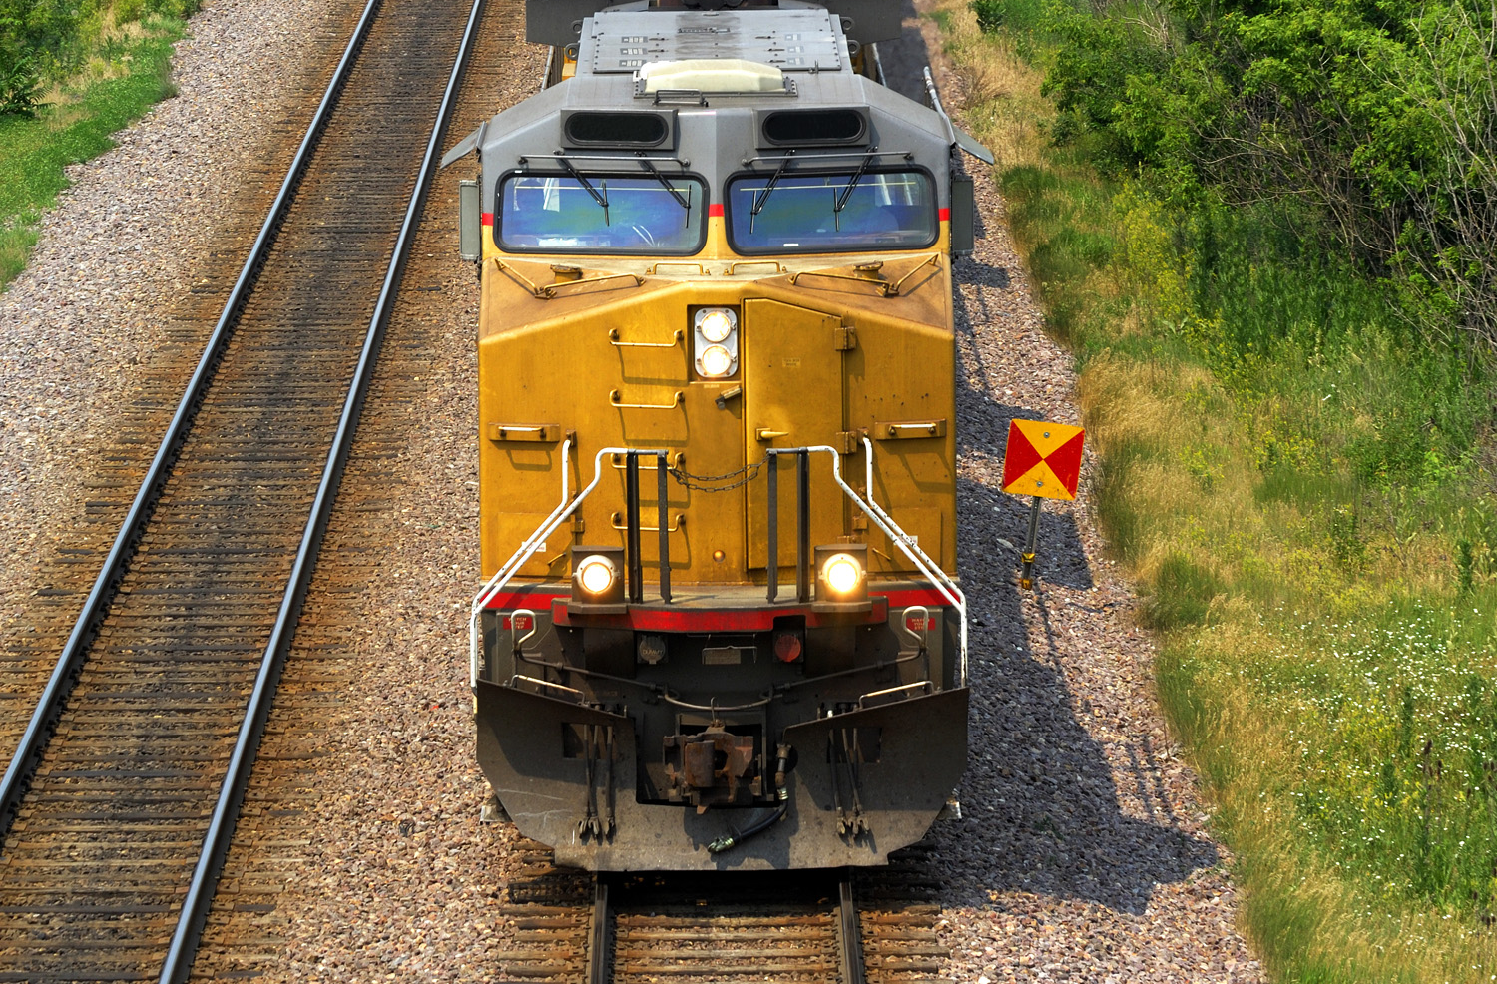
Trains Overhang the Track
3 ft.
3 ft.
Overhang from the rail
Overhang from the rail
Trains can carry loads that are wider than the railroad cars themselves. They can have chains, straps, or other equipment swinging loose from the train.
If you are standing too close, you could get hit.
Copyright © 2014 by Operation Lifesaver, Inc. All rights reserved.

Slide 18
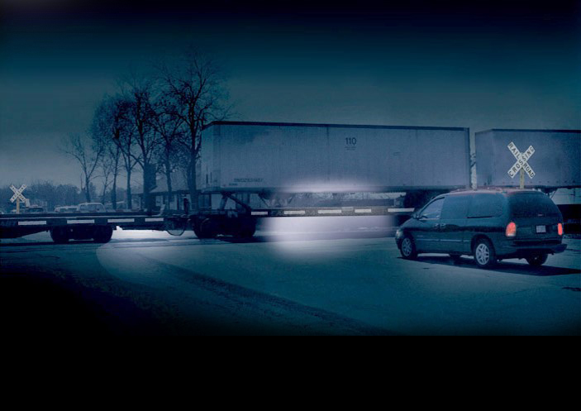
Overdriving Your Headlights
Overdriving your headlights means driving too fast to stop in the distance illuminated by the headlights.
This can result in collisions when motorists run into the side of a train.
Watch for an Advance Warning Sign then slow down and be prepared to stop if a train is approaching.
Always expect a train!
Copyright © 2014 by Operation Lifesaver, Inc. All rights reserved.

Slide 19

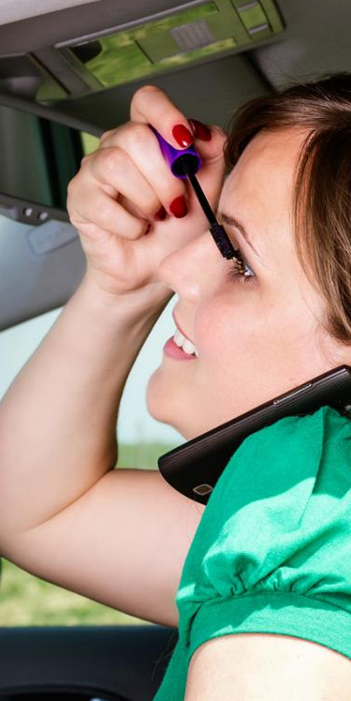
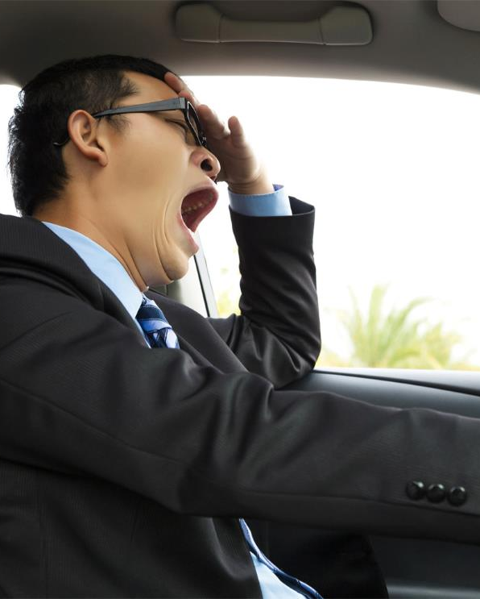
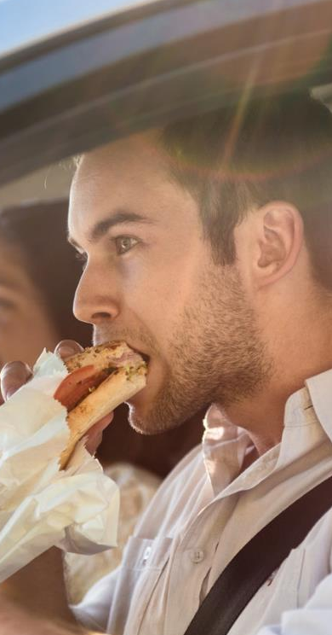
Distractions
Don’t text while driving!
Multi-tasking behind the wheel can be dangerous and even deadly—this is especially true around train tracks.
Avoid driving when tired or after drinking alcohol or taking medications (prescriptions or over the counter) that can blur your vision, cause drowsiness, and impair reaction time.
When approaching railroad tracks, keep your full attention on the road and your surroundings.
Copyright © 2014 by Operation Lifesaver, Inc. All rights reserved.

Slide 20
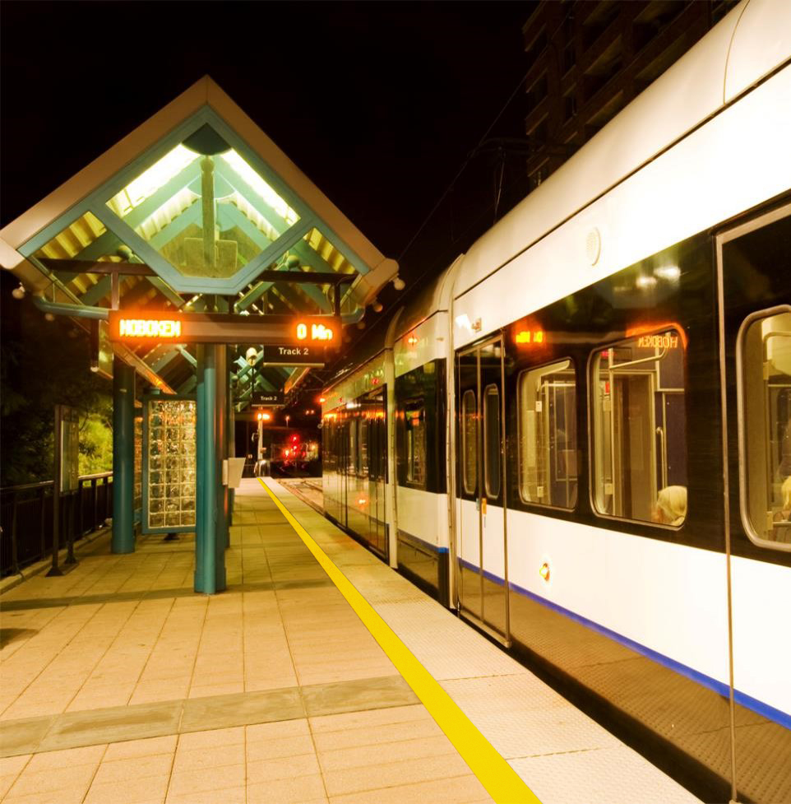
Passenger Trains – The Platform
Trains can run on any track, at any time, from either direction, and can be very quiet.
Obey all signs, announcements,
and signals.
Stand behind the painted or raised platform edge markings.
Never go down onto tracks – they may be electrified. If you drop something, alert a station agent, police officer, or other company personnel.
Copyright © 2014 by Operation Lifesaver, Inc. All rights reserved.

Slide 21
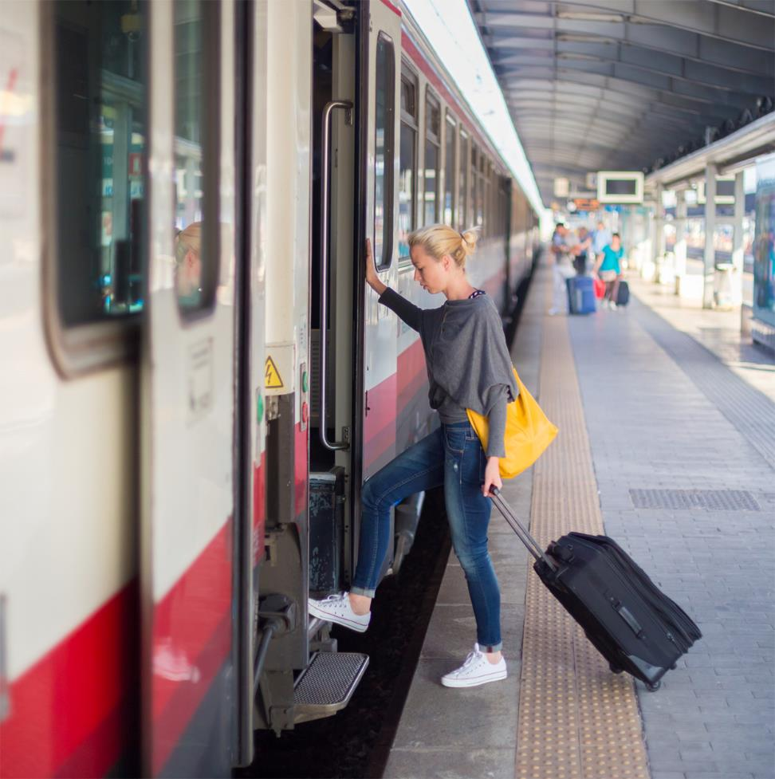
Transit & Passenger Trains –
Riding, Entering, and Exiting
Be careful getting on and off the train—there may be a gap or steps down to the ground.
Hold on tight to poles
or seats.
Listen carefully to directions from the train operator or conductor.
Hold children by the hand as the train moves into or out of the station.
Follow signs letting you know where it is safe to cross the tracks—anywhere else is dangerous and illegal.
Copyright © 2014 by Operation Lifesaver, Inc. All rights reserved.

Slide 22
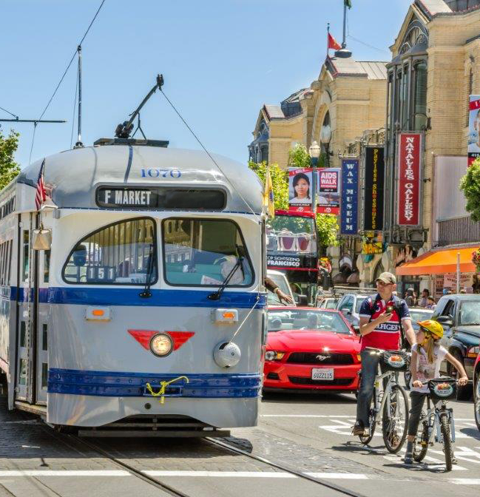
Light Rail and Streetcars
Some transit systems, like light rail and streetcars, run in the street, alongside cars, bicycles, and pedestrians.
When you are walking or biking around these systems:
Cross light rail and streetcar tracks only at designated crossings, and obey all warnings, signals, lights, and signs.
Do not walk or ride your bike along the tracks.
When you cross the tracks on your bike, dismount and walk across at a 90-degree angle.
Never run to catch the train or streetcar, or try to board when
it’s moving.
Watch your step getting on and
off the train or streetcar.
Copyright © 2014 by Operation Lifesaver, Inc. All rights reserved.

Slide 23
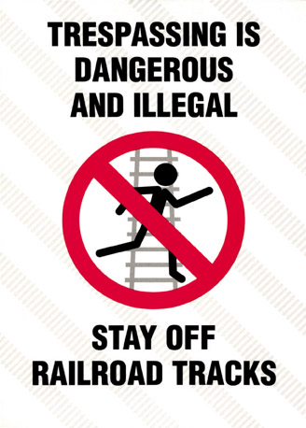
Stay Off! Stay Away! Stay Alive!®
Railroad property is private property.
Being on railroad tracks or property without permission is trespassing, even if a sign is not posted.
Taking a shortcut across the tracks can get you seriously injured or killed.
Copyright © 2014 by Operation Lifesaver, Inc. All rights reserved.

Slide 24
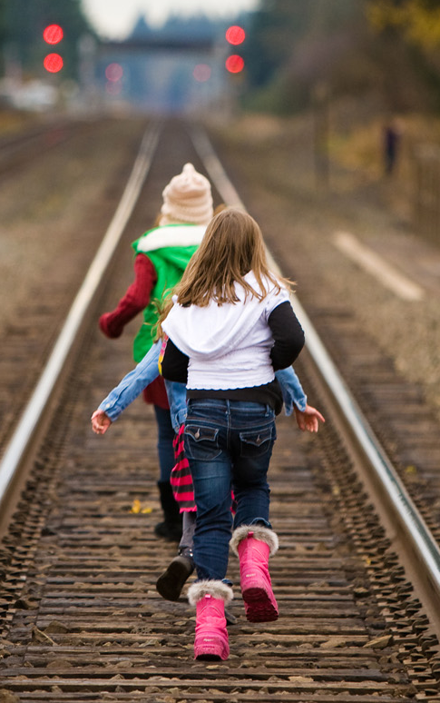
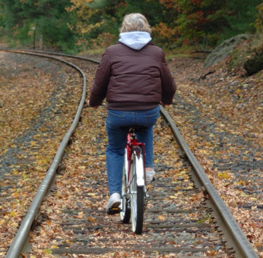
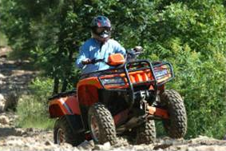
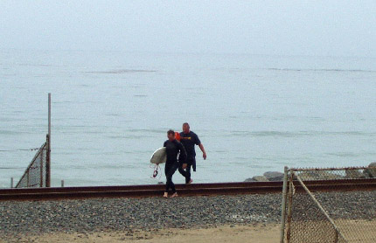
Trespassing
Stay Off!
Stay Away!
Stay Alive!®
Recreational activities do not mix with railroad tracks—you are trespassing.
Listening to music near railroad tracks may prevent you from hearing the
train horn.
Train crews are not expecting people on or near the tracks. You may not be able to hear a warning in time.
Copyright © 2014 by Operation Lifesaver, Inc. All rights reserved.

Slide 25
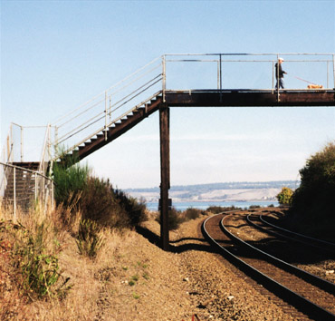
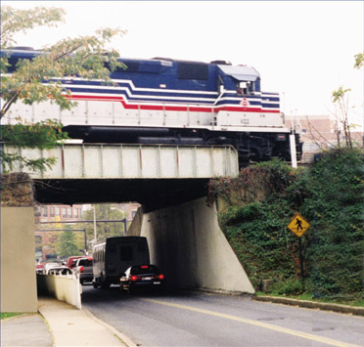
Where Do You Cross the Tracks?
Pedestrians should cross tracks at a designated crossing, either where cars cross, or at a pedestrian overpass or underpass.
Use designated sidewalks when available.
Copyright © 2014 by Operation Lifesaver, Inc. All rights reserved.

Slide 26
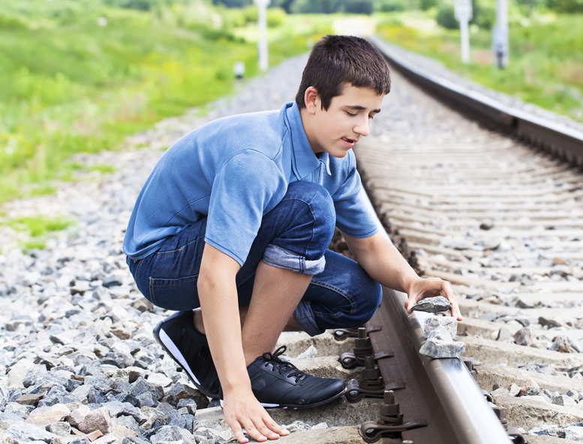
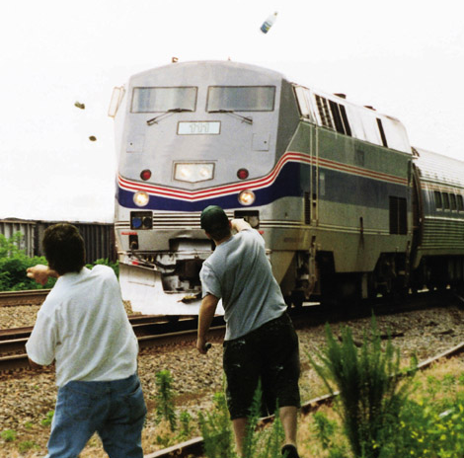
Objects and Trains Do Not Mix
Throwing objects at trains is against the law. Any object thrown at a moving train can bounce back with deadly force.
Placing objects on the rails is illegal and potentially deadly.
Copyright © 2014 by Operation Lifesaver, Inc. All rights reserved.

Slide 27
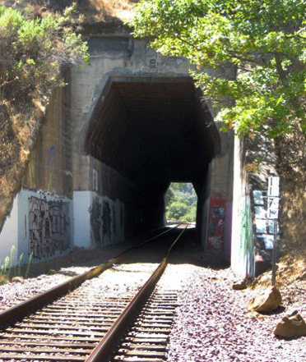
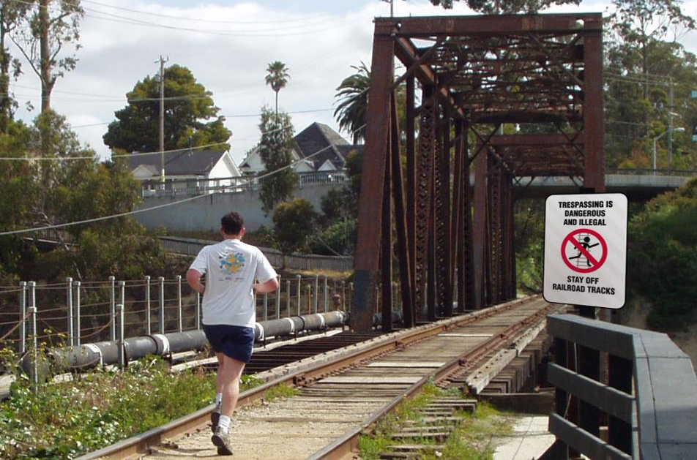
Tunnels, Bridges, and Trestles
Railroad bridges, tunnels, and trestles are private property—enter and you are trespassing.
If you are trespassing on a bridge with a train approaching, you have two choices: jump or get hit. Tunnels, bridges, and trestles are only
designed for trains.
Copyright © 2014 by Operation Lifesaver, Inc. All rights reserved.

Slide 28
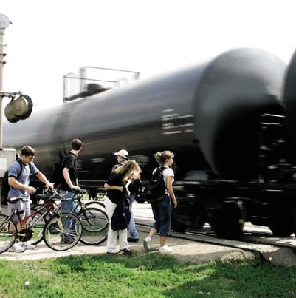
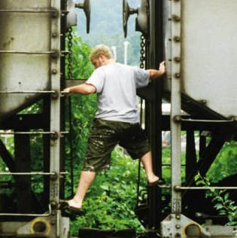
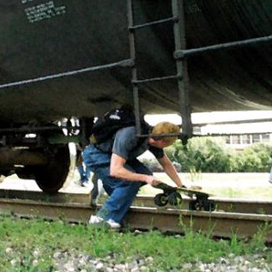
Trains Can Move Without Warning
Playing On
Under
Too Close
Do not play on rail cars. When the train starts to move, the rail cars often jerk with enough force to knock you off.
Don’t stand too close to the tracks. Overhanging equipment can hit you causing serious injuries or death.
Don’t crawl under rail cars. Trains move without warning. You can lose an arm, a leg, or even worse.
Copyright © 2014 by Operation Lifesaver, Inc. All rights reserved.

Slide 29
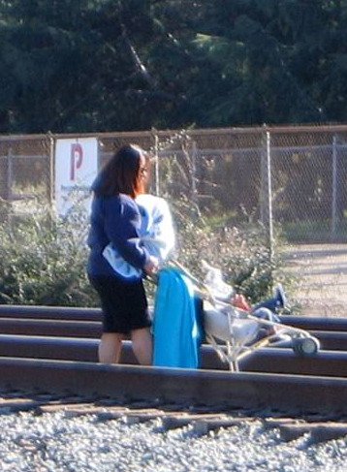
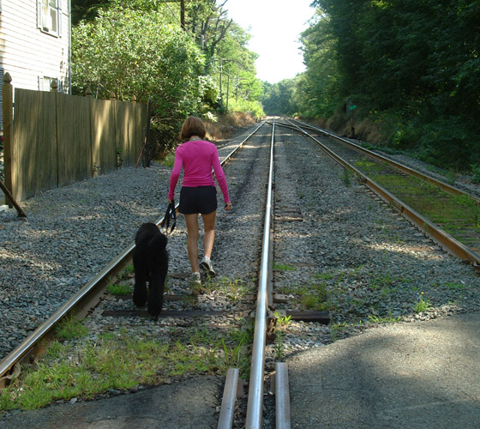
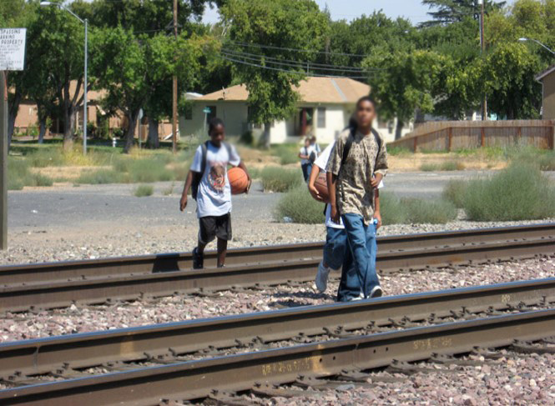
Do Not Walk on Tracks
Walking on railroad tracks is dangerous and illegal.
Many people believe they will always hear a train coming, but some trains are silent and difficult to hear.
Engaging in conversation, speaking on a cell phone, and listening to music are all potentially deadly distractions.
Trains can run on any track, at
any time, from either direction.
Walking, lying, or sitting on the tracks can cause injuries and even death.
Tracks are for trains, not for people—Stay Off! Stay Away! Stay Alive!
Copyright © 2014 by Operation Lifesaver, Inc. All rights reserved.

Slide 30
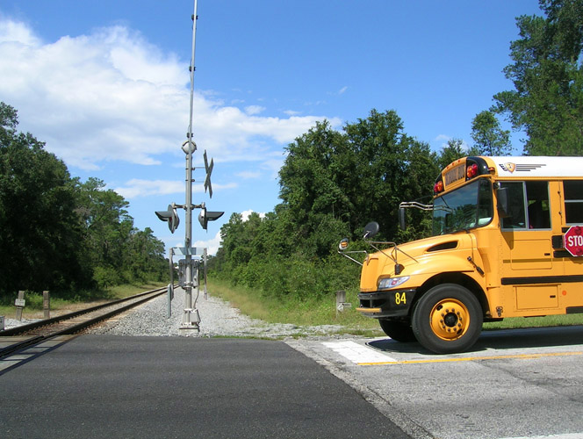
School Buses
Know the length
of your bus so you can fully clear the track.
After stopping, you can inch forward to see further down the track if necessary.
Create an evacuation plan in case the bus stalls or is trapped on
the tracks.
You should know and follow the policies of your jurisdiction.
School Buses should stop
15 to 50 feet from the
nearest rail.
Copyright © 2014 by Operation Lifesaver, Inc. All rights reserved.

Slide 31

Hazardous Materials
Federal regulations require all trucks carrying hazardous material to stop at
all railroad crossings.
Drivers must ensure a train is not approaching and that they have sufficient time and space to make it across the tracks safely.
Know the length of your vehicle.
Don’t stop with the front or back of your vehicle closer than 15 feet from the nearest rail.
Copyright © 2014 by Operation Lifesaver, Inc. All rights reserved.

Slide 32



Exempt Signs and Crossings
Certain vehicles are required to stop at all grade crossings unless there is an exempt sign posted. Refer to your local and state laws and company policies for additional information.
Copyright © 2014 by Operation Lifesaver, Inc. All rights reserved.

Slide 33

Hump Crossings
Due to close clearance to the road, trucks and many trailers are prohibited from using these crossings.
When you see this warning sign, find another way across the tracks.
Be aware that crossings may not have this sign, so pay attention to the roadway at all times.
Copyright © 2014 by Operation Lifesaver, Inc. All rights reserved.

Slide 34

Electrification
The third rail carries high voltage of direct current and provides electrical power to the train.
High voltage of electricity powers
trains up to 150 mph.
Never walk next to or in between rails.
Never climb on top of trains or play with the overhead network of wires.
Copyright © 2014 by Operation Lifesaver, Inc. All rights reserved.

Slide 35

Train and Car Collisions
Two construction workers were late for work.
They approached a properly operating railroad crossing with the gates down.
After waiting for the train to pass, they drove around the lowered crossing gates thinking it was safe.
They were struck by an oncoming train on the other tracks.
Never drive around
lowered gates.
Copyright © 2014 by Operation Lifesaver, Inc. All rights reserved.

Slide 36

Train and Truck Collisions
Collisions between tractor-trailers and trains cause severe damage. This truck was shoved a great distance from the crossing.
Reasons a tractor-trailer could get hit by a train:
The driver may fail to look
for an oncoming train.
The driver may try to beat
the train.
Low clearance can cause
the trailer to get hung up
on the tracks.
Copyright © 2014 by Operation Lifesaver, Inc. All rights reserved.

Slide 37
Look, Listen & Live
Look both ways!
Listen for the sound of a train!
If you look and listen, you will live!
Copyright © 2014 by Operation Lifesaver, Inc. All rights reserved.

Slide 38

Road Parallels Track
This sign warns that the next turn will immediately approach a railroad crossing. Drivers should slow down and make the turn with caution and look for an approaching train.
Copyright © 2014 by Operation Lifesaver, Inc. All rights reserved.

Slide 39

Farm Machinery – Where to Cross
Cross only
at approved crossings.
Crossing the tracks, other than at a grade crossing, is dangerous and illegal.
Large equipment takes longer to clear the tracks than a small motor vehicle.
Don’t try to beat the train to
the crossing.
Combines, sprayers, and other equipment are really big, but
not as big as a 12 million
pound train.
Copyright © 2014 by Operation Lifesaver, Inc. All rights reserved.

Slide 40

Farm Machinery – Crossing Safely
Slow down as you approach
every crossing.
Do not stop closer than 15 feet
or further than 50 feet from the nearest rail.
Turn off radios and air conditioners.
Open your door or window to listen for a train.
Watch for hump crossing signs where a close clearance can cause you to get hung-up on
the tracks.
If you get stuck, get out of your vehicle and look for an emergency phone number to contact the railroad—if you can’t find it, call 911.
Copyright © 2014 by Operation Lifesaver, Inc. All rights reserved.

Slide 41

Working Near Tracks
If your job requires you to dig, survey, inspect, or work near the tracks, contact the railroad before the work begins. The railroad company will be able to assist you in working safely near their tracks.
Copyright © 2014 by Operation Lifesaver, Inc. All rights reserved.

Slide 42


See Tracks? Think Train!
Copyright © 2014 by Operation Lifesaver, Inc. All rights reserved.

Slide 43

See Tracks? Think Train!
Copyright © 2014 by Operation Lifesaver, Inc. All rights reserved.

Slide 44

See Tracks? Think Train!
Copyright © 2014 by Operation Lifesaver, Inc. All rights reserved.

Slide 45

See Tracks? Think Train!
Copyright © 2014 by Operation Lifesaver, Inc. All rights reserved.

Slide 46


See Tracks? Think Train!
Copyright © 2014 by Operation Lifesaver, Inc. All rights reserved.

Slide 47
Thank You
Copyright © 2014 by Operation Lifesaver, Inc. All rights reserved.

